Slide 1
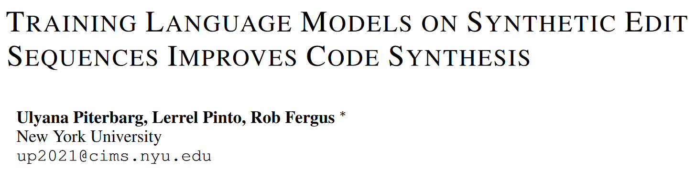
ICLR 2025 under review: 8 6 6 6

Slide 2
Abstract
Problem
Human engineers mainly write code by editing existing programs. But LMs generate programs in a single pass. We think the reason is the scarcity of sequential edit data.
Our approach
LintSeq, a synthetic data generation algorithm that refactors existing code into a sequence of code edits.
Experiments
We use it to refactor a dataset of instruction + program pairs into instruction + program-diff-sequence tuples.
We instruction-finetune a series of smaller LLMs (2.6B - 14B) on both versions of the dataset, and compare them on HumanEval, MBPP(+), CodeContests, DS-100 and BigCodeBench.
LintSeq finetuned models match or outperform baselines on pass@1, and exhibit better scaling across higher pass@k as a function of total test-time compute.

Slide 3
How humans write program
Consistent and correct zero-shot generation in code synthesis is hard for small models. Code generation is both structured and long-form.
Humans tackle these problems by leveraging abstract mental models, first developing a plan and then execute the plan one step at a time.
Example: a software engineer might employ OOP when creating a new code-base by developing a "class" object and then gradually add new functionality to this class.

Slide 4
Disadvantage of autoregressive generation of programs
But LMs are trained to autoregressively synthesize the entire program from scratch. This makes repeatedly editing a program with an LM extremely expensive.
Example: Cursor repeatedly prompt models to rewrite entire programs during every edit generation call.
Longer sequences also suffer from degrading quality and limited diversity across samples.
There is no reliable trade-off between zero-shot generation quality and inference-time compute cost under current paradigm of autoregressive code synthesis, especially for smaller LMs.

Slide 5
Generate programs edit-by-edit
Re-parameterize code synthesis as a sequential edit problem.
We propose that models be trained to generate code edit-by-edit.
But existing commit datasets are not suitable.
They contain limited sequential data.
Different granularity: commits reflect when programmers save code, but not necessarily how they write and/or reason about it.
We introduce a new algorithm, that leverages linters to express any program as a sequence of structured code edits.

Slide 6
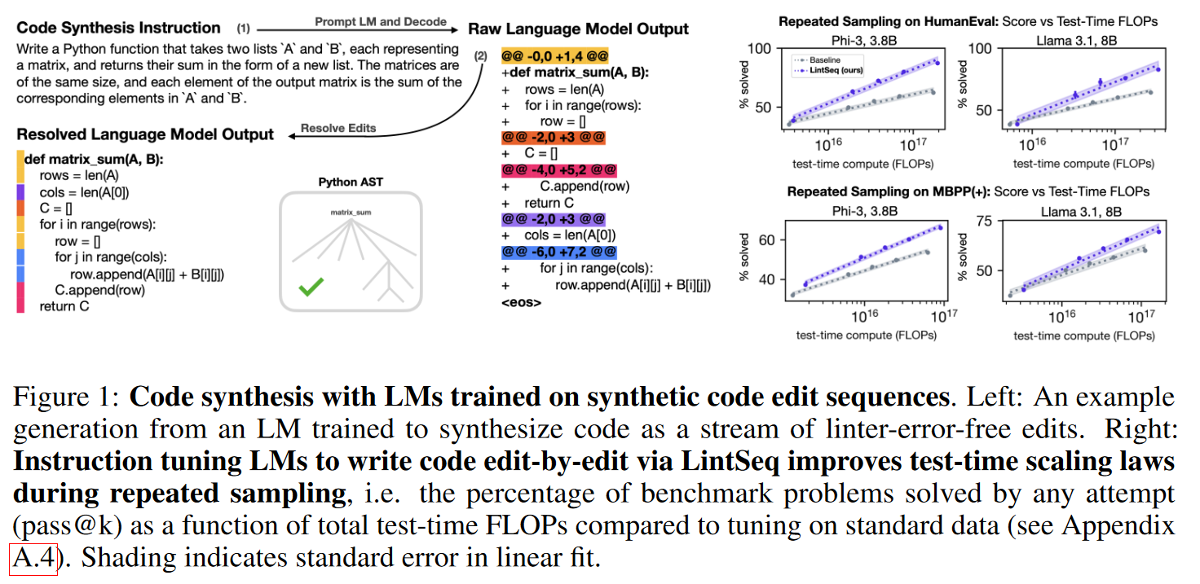
Code synthesis demo

Slide 7
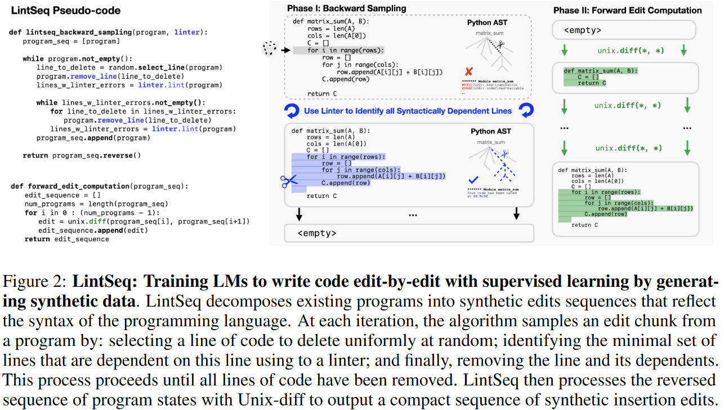
LintSeq: Code Synthesis as a Sequential Edit Problem

Slide 8
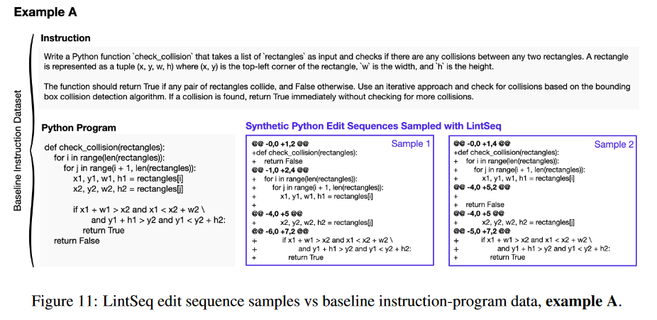
LintSeq example

Slide 9
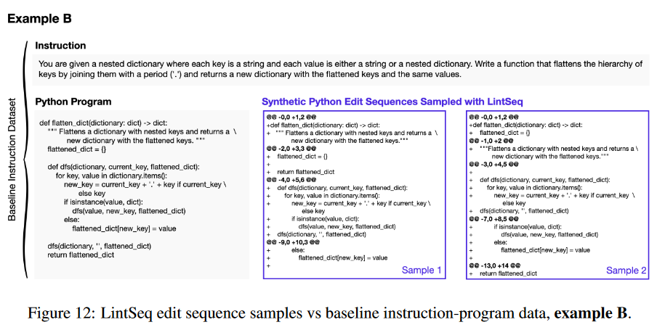
LintSeq example

Slide 10
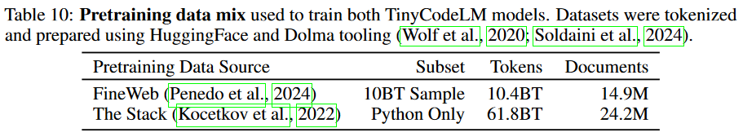
Experimental setups - Pretraining
Architecture: 2 decoder-only transformers, 150M and 400M, two smallest versions of GPT-2, but integrates the arch changes in OLMo.
Data: 72B tokens of web text (sampled from FineWeb) and raw Python (sampled from The Stack).
Other info: 2 epochs, batch size 524,288 tokens. On 4 H100s.

Slide 11
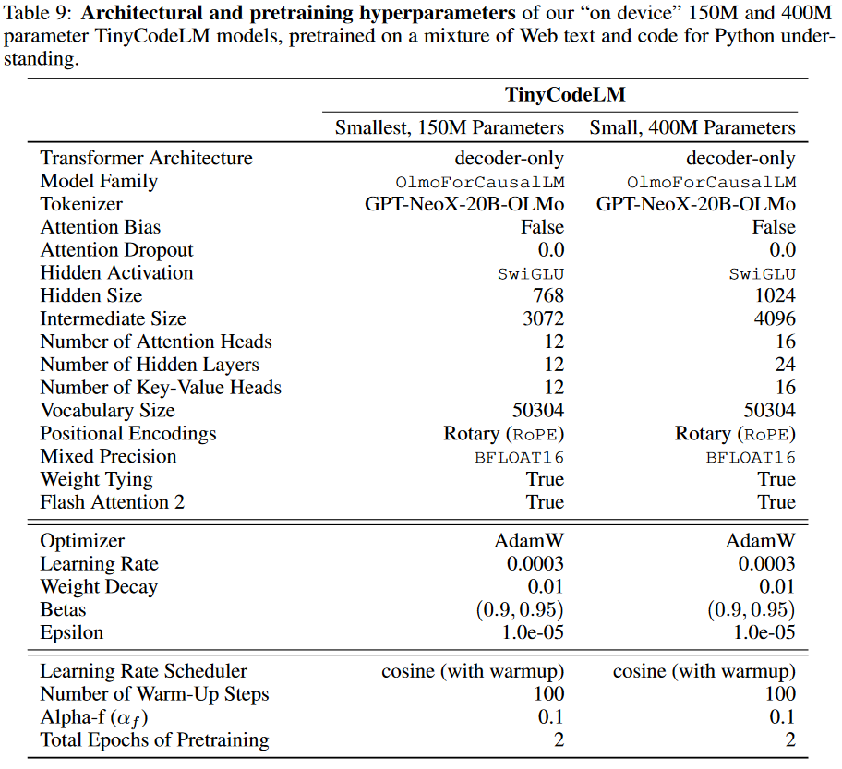
Experimental setups - Pretraining

Slide 12
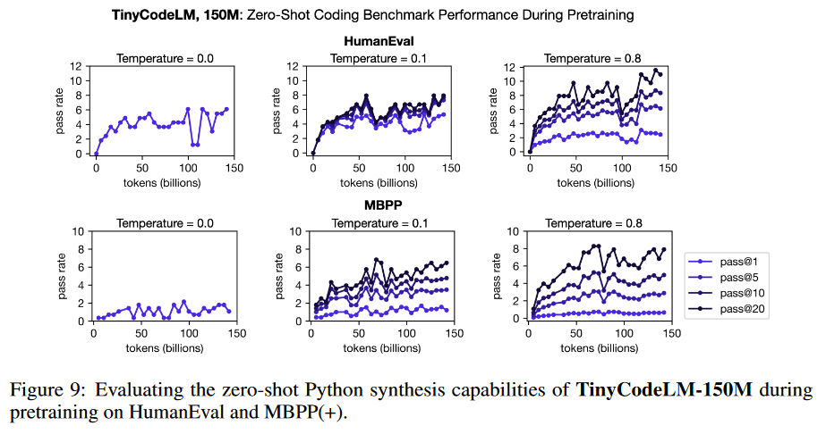
TinyCodeLM performance during pretraining

Slide 13
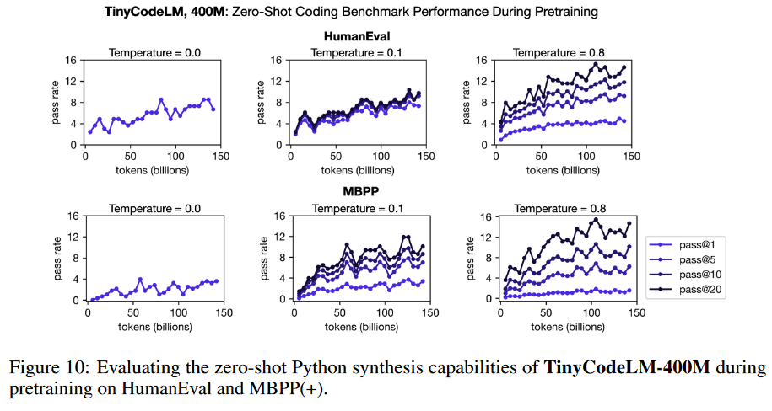
TinyCodeLM performance during pretraining

Slide 14
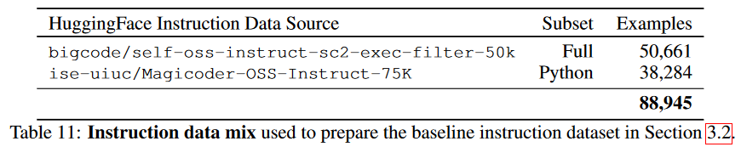
Experimental setup - Finetune
Data source: Magicoder (GPT 3.5/4-based) + StarCoder2-15B (self-alignment), only Python. They are generated with OSS-Instruct and decontaminated. We strip any chain-of-thought-like NL explanations.
Dataset size: >88900 instruction-Python pairs.
LintSeq dataset: generate 5 edit sequences for each pair using pylint.
Optimizer etc: same optimizer steps when comparing baseline dataset and LintSeq dataset, with same learning rate schedule.

Slide 15
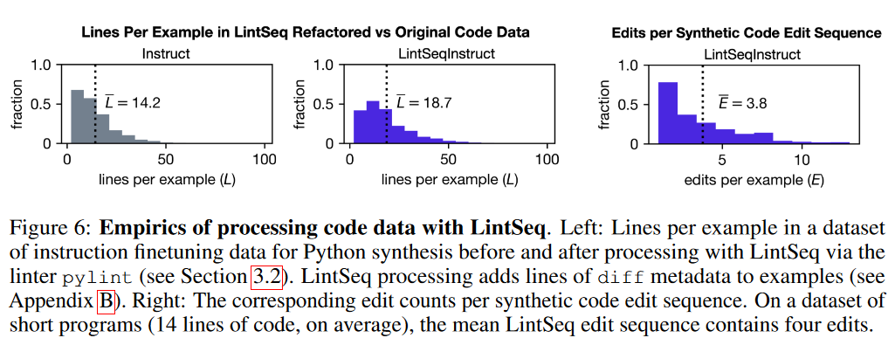
Dataset statistics

Slide 16
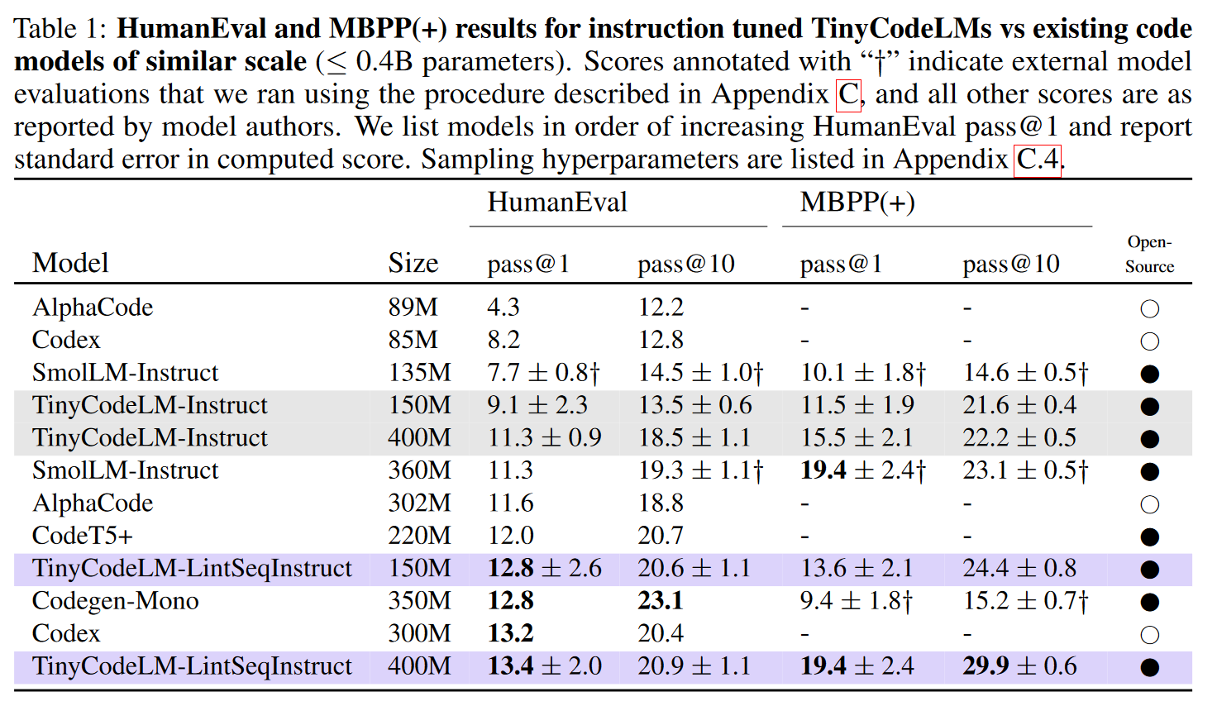
Experiment results

Slide 17
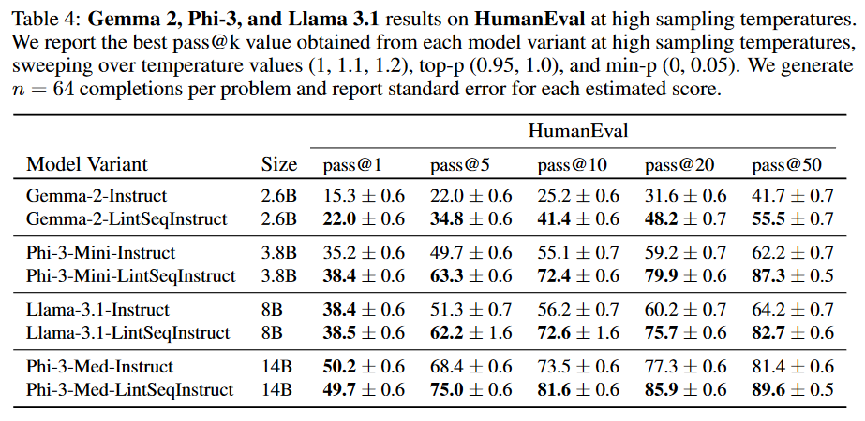
Experiment results

Slide 18
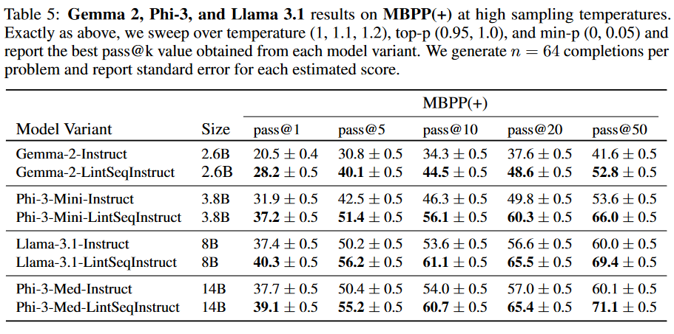
Experiment results

Slide 19
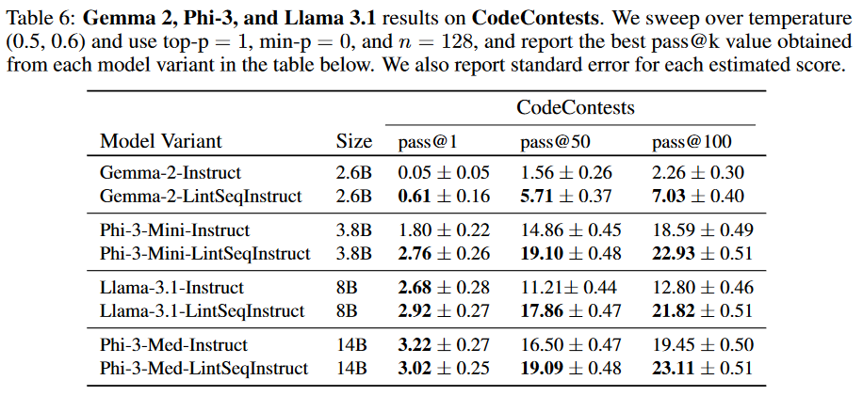
Experiment results

Slide 20
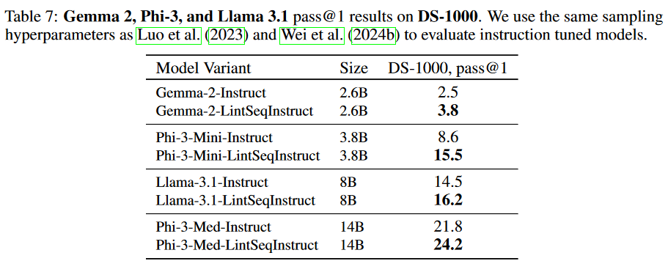
Experiment results

Slide 21
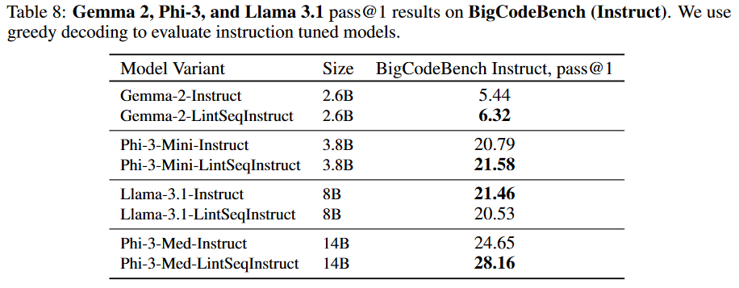
Experiment results

Slide 22
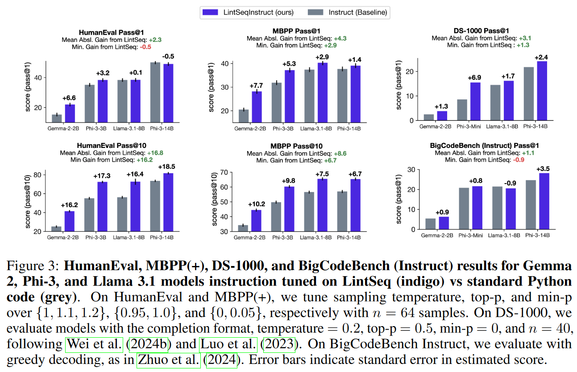
Experiment results

Slide 23
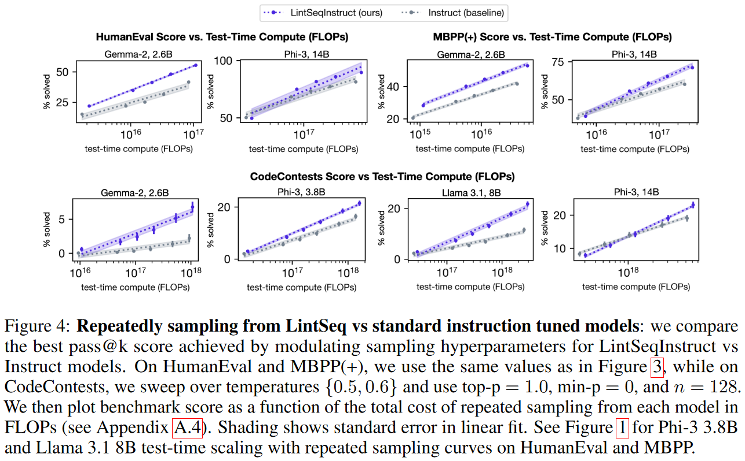
Experiment results

Slide 24
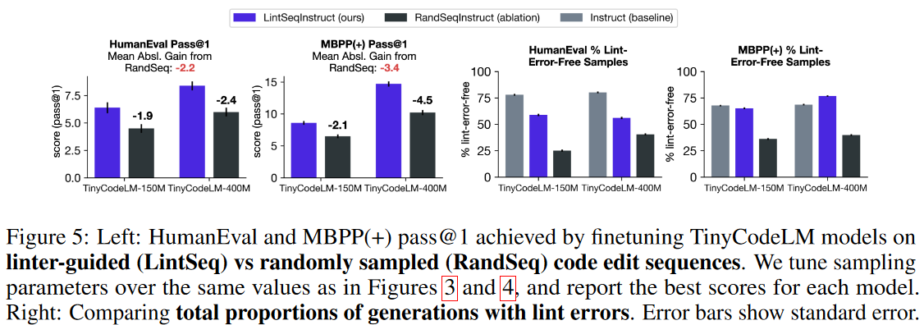
Linter ablation experiments - vs random edit

Slide 25
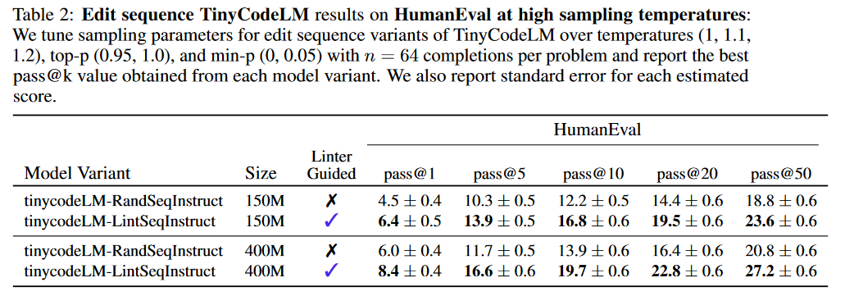
Linter ablation experiments - vs random edit

Slide 26
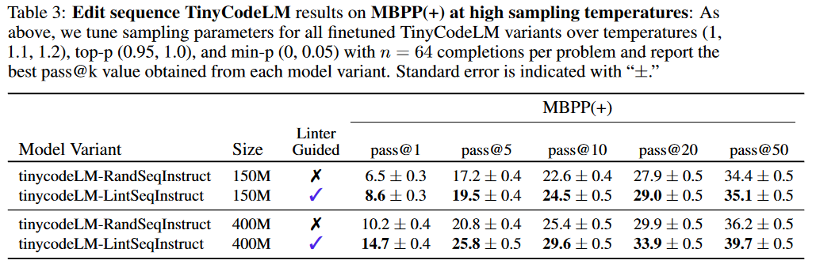
Linter ablation experiments - vs random edit

Slide 27
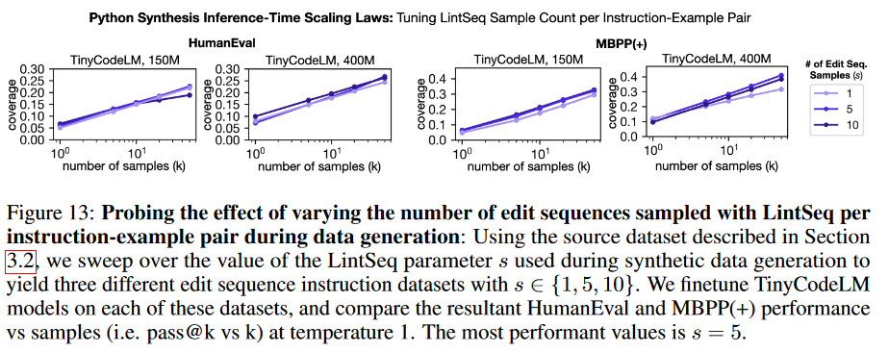
Ablation experiment on sample count

Slide 28
Discussion & Limitations
Can only be used to generate synthetic sequences of insertion edits. > Mix human edit data? Use RL?
Only Python is used. > Other programming languages are similar.
Only fine-tuning is discussed in this paper. > We hope to explore using LintSeq to train LMs to write code edit-by-edit.

